Slide 1

Foundations of Cryptography DES, double DES, triple DES, $ℤ_{n}$, $ℤ_{n}^{∗}$
LiangFeng Zhang
zhanglf@shanghaitech.edu.cn
SIST, ShanghaiTech, 2019F

Slide 2
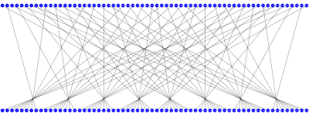
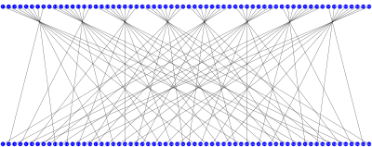
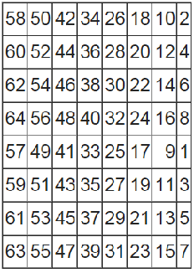
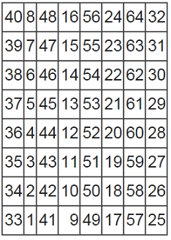





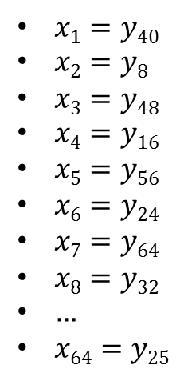
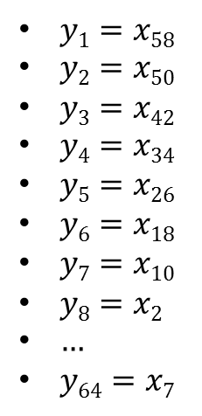

Initial Permutation IP
$$x=x1x2x3⋯x64$$
$$y=y1y2y3⋯y64$$
$$y=y1y2y3⋯y64$$
$$x=x1x2x3⋯x64$$
$$IP$$
$IP^{−1}$
$y1=x58$
$y2=x50$
$y3=x42$
$y4=x34$
$y5=x26$
$y6=x18$
$y7=x10$
$y8=x2$
$…$
$y64=x7$
$x1=y40$
$x2=y8$
$x3=y48$
$x4=y16$
$x5=y56$
$x6=y24$
$x7=y64$
$x8=y32$
$…$
$x64=y25$

Slide 3
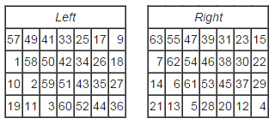
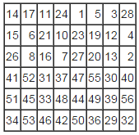








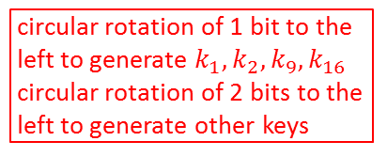







Key Schedule
64-bit key $K$
$$PC1$$
PC1
circular rotation of 1 bit to the
left to generate $k_{1},k_{2},k_{9},k_{16}$
circular rotation of 2 bits to the
left to generate other keys
28-bit
28-bit
<
<
28-bit
28-bit
PC2
48-bit $k1$
<
<
28-bit
28-bit
PC2
48-bit $k2$
64-bit $K→$ 56-bit $k$
<<
<<
$$PC2$$
28-bit
28-bit
PC2
48-bit $k3$
$$⋮$$
$$⋮$$
<
<
28-bit
28-bit
PC2
48-bit $k9$
<<
<<
28-bit
28-bit
PC2
48-bit $k10$
$$⋮$$
$$⋮$$
<
<
56-bit$→$48-bit
28-bit
28-bit
PC2
48-bit $k16$

Slide 4







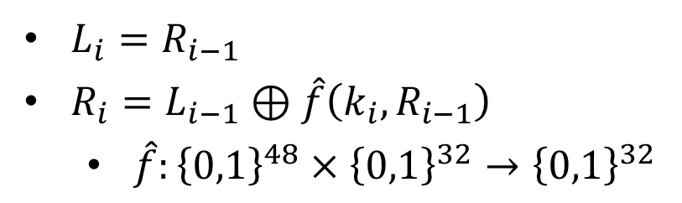
$$F(k_{i},L_{i−1}||R_{i−1})$$
32-bit
32-bit
$$L_{i−1}$$
$R_{i−1}$
$$⊕$$
$L_{i}=R_{i−1}$
$R_{i}=L_{i−1}⊕\hat{f}\left(k_{i}, R_{i−1}\right)$
$\hat{f}:{\left\{0,1\right\}}^{48}×{\left\{0,1\right\}}^{32}→{\left\{0,1\right\}}^{32}$
$$\hat{f}(k_{i},⋅)$$
$L_{i}$
$R_{i}$

Slide 5
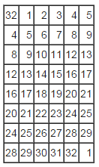
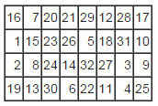
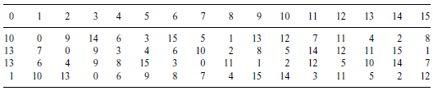























The DES Mangler Function $\hat{f}(k_{i},⋅)$
$$32 bits$$
$$48 bits$$
$R_{i−1}$
$k_{i}$
$$E$$
$$48 bits$$
$$P$$
$$⊕$$
$$48 bits$$
$E$/ expansion function
$$S1$$
$$S2$$
$$S3$$
$$S4$$
$$S5$$
$$S6$$
$$S7$$
$$S8$$
$$32 bits$$
$$P$$
$$S3$$
$$\hat{f}(k_{i},R_{i−1})$$

Slide 6
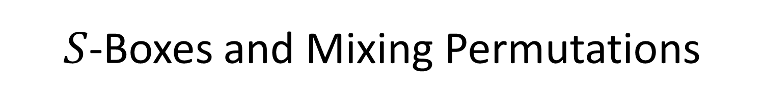
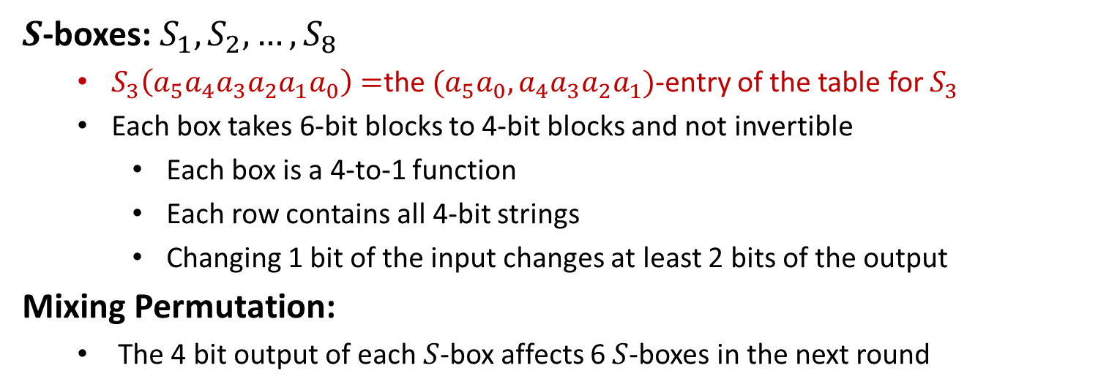
$S$-Boxes and Mixing Permutations
$S$-boxes: $S_{1}, S_{2},…,S_{8}$
$S_{3}\left(a_{5}a_{4}a_{3}a_{2}a_{1}a_{0}\right)=$the $(a_{5}a_{0},a_{4}a_{3}a_{2}a_{1})$-entry of the table for $S_{3}$
Each box takes 6-bit blocks to 4-bit blocks and not invertible
Each box is a 4-to-1 function
Each row contains all 4-bit strings
Changing 1 bit of the input changes at least 2 bits of the output
Mixing Permutation:
The 4 bit output of each $S$-box affects 6 $S$-boxes in the next round

Slide 7





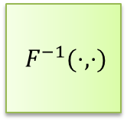







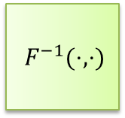








DES Decryption
$56$-bit
secret key $k$
key expansion
$48$-bit
$$k1$$
$$k2$$
$$⋯$$
$$k16$$
$F^{−1}(⋅,⋅)$
$F^{−1}(⋅,⋅)$
$F^{−1}(⋅,⋅)$
$$m$$
$$IP^{−1}$$
$$⋯$$
$$IP$$
$$SW$$
$$c$$
$$L_{0},R_{0}$$
$$L_{1},R_{1}$$
$$L_{2},R_{2}$$
$$L_{16},R_{16}$$
$64$-bit
$64$-bit
The DES Decryption: inverse $F\left(k_{1},⋅\right),…,F(k_{16},⋅)$
$R_{i−1}=L_{i}, L_{i−1}=R_{i}⊕\hat{f}(k_{i},L_{i})$

Slide 8
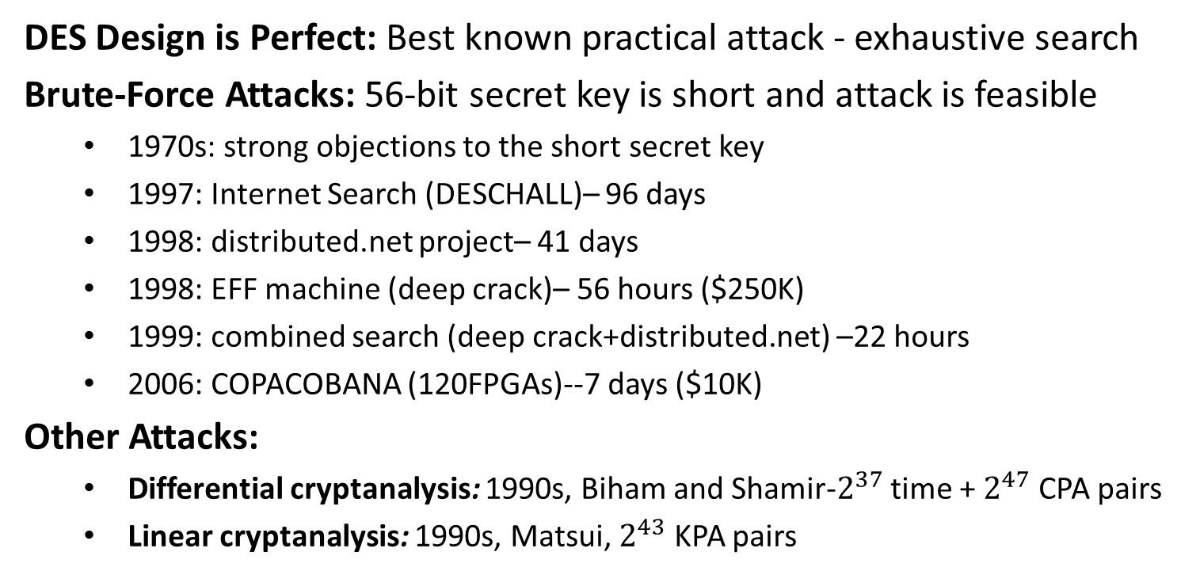
Security
DES Design is Perfect: Best known practical attack - exhaustive search
Brute-Force Attacks: 56-bit secret key is short and attack is feasible
1970s: strong objections to the short secret key
1997: Internet Search (DESCHALL)– 96 days
1998: distributed.net project– 41 days
1998: EFF machine (deep crack)– 56 hours ($250K)
1999: combined search (deep crack+distributed.net) –22 hours
2006: COPACOBANA (120FPGAs)--7 days ($10K)
Other Attacks:
Differential cryptanalysis: 1990s, Biham and Shamir-$2^{37}$ time + $2^{47}$ CPA pairs
Linear cryptanalysis: 1990s, Matsui, $2^{43}$ KPA pairs

Slide 9
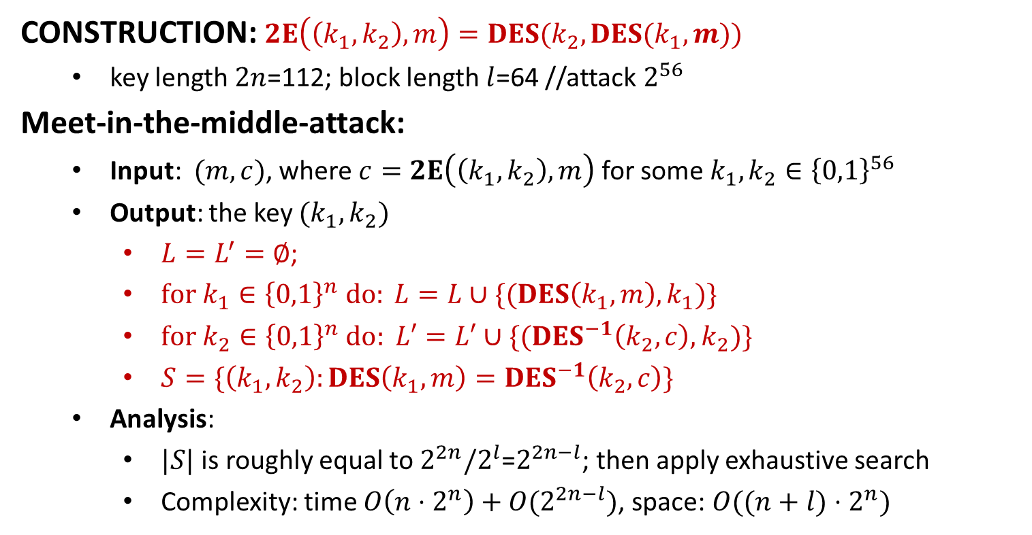
Double DES
CONSTRUCTION: $2E\left(\left(k_{1},k_{2}\right), m\right)=DES(k_{2},DES(k_{1},m))$
key length $2n$=112; block length $l$=64 //attack $2^{56}$
Meet-in-the-middle-attack:
Input: $(m,c)$, where $c=2E\left(\left(k_{1},k_{2}\right), m\right)$ for some $k_{1},k_{2}∈{\left\{0,1\right\}}^{56}$
Output: the key $(k_{1},k_{2})$
$L=L^{′}=∅$;
$for k_{1}∈{\left\{0,1\right\}}^{n} do: L=L∪\{(DES\left(k_{1},m\right),k_{1})\}$
$for k_{2}∈{\left\{0,1\right\}}^{n}$ $do: L′=L′∪\{(DES^{−1}\left(k_{2},c\right), k_{2})\}$
$S=\{\left(k_{1},k_{2}\right):DES\left(k_{1},m\right)=DES^{−1}\left(k_{2},c\right)\}$
Analysis:
$|S|$ is roughly equal to $2^{2n}/2^{l}$=$2^{2n−l}$; then apply exhaustive search
Complexity: time $O\left(n⋅2^{n}\right)+O(2^{2n−l})$, space: $O((n+l)⋅2^{n})$

Slide 10
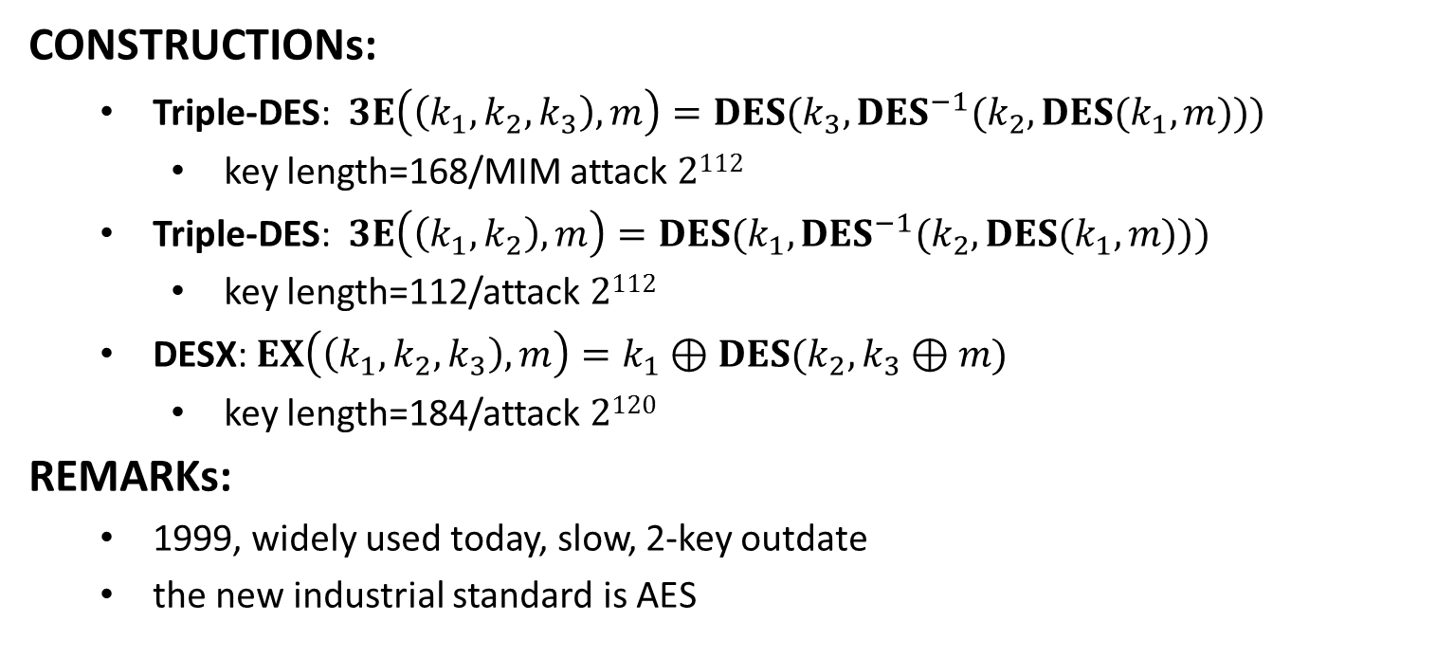
Triple DES
CONSTRUCTIONs:
Triple-DES: $3E\left(\left(k_{1},k_{2},k_{3}\right), m\right)=DES(k_{3},DES^{−1}(k_{2},DES(k_{1},m)))$
key length=168/MIM attack $2112$
Triple-DES: $3E\left(\left(k_{1},k_{2}\right), m\right)=DES(k_{1},DES^{−1}(k_{2},DES(k_{1},m)))$
key length=112/attack $2112$
DESX: $EX\left(\left(k_{1},k_{2},k_{3}\right),m\right)=k_{1}⊕DES(k_{2},k_{3}⊕m)$
key length=184/attack $2120$
REMARKs:
1999, widely used today, slow, 2-key outdate
the new industrial standard is AES

Slide 11
Advanced Encryption Standard
The History of Advanced Encryption Standard (AES): FIPS 197
1997: NIST called for Advanced Encryption Standard
1998: 15 proposals were submitted/ the 1st AES workshop
1999: 5 submissions were selected/the 2nd AES workshop
2000: NIST adopted Rijndael (Belgium) /the 3rd AES workshop
The Basics of Advanced Encryption Standard (AES):
key length: 128-bit, 192-bit, or 256-bit
block length: 128-bit
number of rounds: 10, 12, 14
suitable for software & hardware implementations
key recovery attack: 4 times better than brute-force attack
substation-permutation network

Slide 13
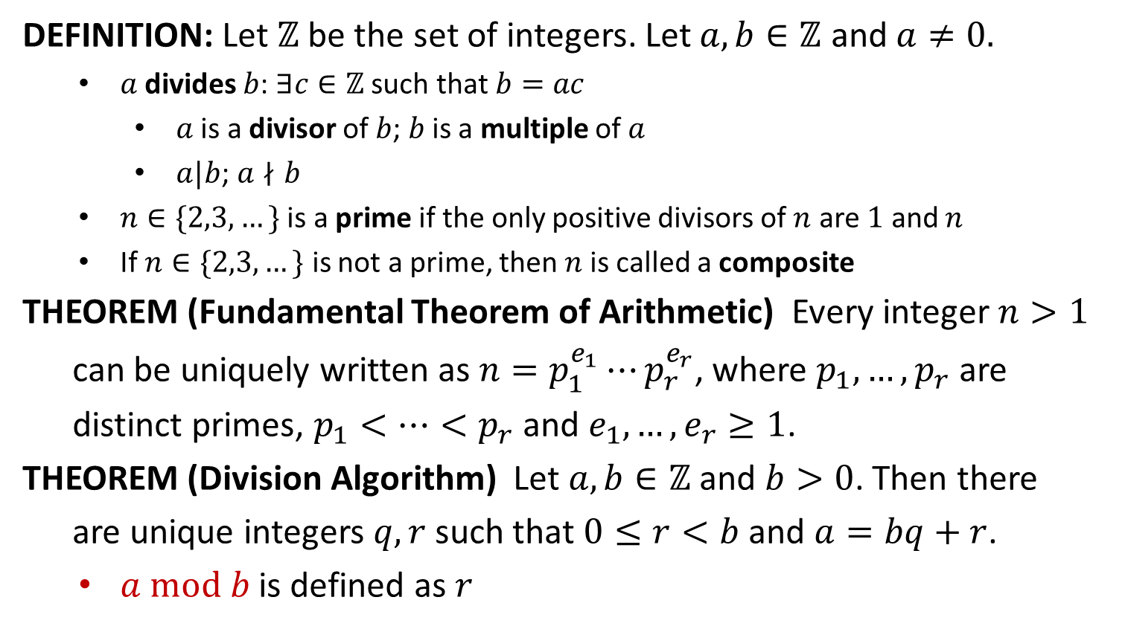
Divisibility
DEFINITION: Let $ℤ$ be the set of integers. Let $a,b∈ℤ$ and $a≠0.$
$a$ divides $b$: $∃c∈ℤ$ such that $b=ac$
$a$ is a divisor of $b$; $b$ is a multiple of $a$
$a|b$; $a∤b$
$n∈\{2,3,…\}$ is a prime if the only positive divisors of $n$ are $1$ and $n$
If $n∈\{2,3,…\}$ is not a prime, then$n$is called a composite
THEOREM (Fundamental Theorem of Arithmetic) Every integer $n>1$
can be uniquely written as $n=p_{1}^{e_{1}}⋯p_{r}^{e_{r}}$, where $p_{1},…,p_{r}$ are
distinct primes, $p_{1}<…<p_{r}$ and $e_{1},…,e_{r}≥1$.
THEOREM (Division Algorithm) Let $a,b∈ℤ$ and $b>0$. Then there
are unique integers $q,r$ such that $0≤r<b$ and $a=bq+r$.
$a mod b$ is defined as $r$

Slide 14
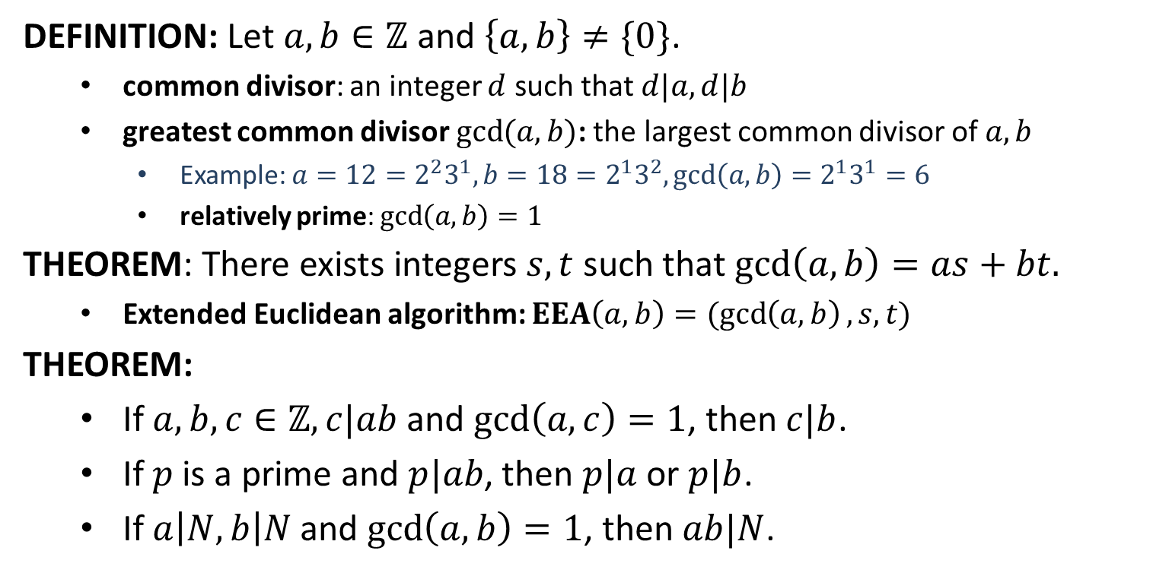
Greatest Common Divisor
DEFINITION: Let $a,b∈ℤ$ and $\left\{a,b\right\}≠\{0\}$.
common divisor: an integer $d$ such that $d|a, d|b$
greatest common divisor $\gcd{(a,b)}$: the largest common divisor of $a,b$
Example: $a=12=2^{2}3^{1}, b=18=2^{1}3^{2}, gcd\left(a,b\right)=2^{1}3^{1}=6$
relatively prime: $\gcd\left(a,b\right)=1$
THEOREM: There exists integers $s,t$ such that $\gcd\left(a,b\right)=as+bt.$
Extended Euclidean algorithm: $EEA\left(a,b\right)=(\gcd\left(a,b\right), s,t)$
THEOREM:
If $a,b,c∈ℤ, c|ab$and $\gcd\left(a,c\right)=1$, then $c|b$.
If $p$ is a prime and $p|ab$, then $p|a$ or $p|b$.
If $a\left|N, b\right|N$ and $\gcd\left(a,b\right)=1$, then $ab|N$.

Slide 15
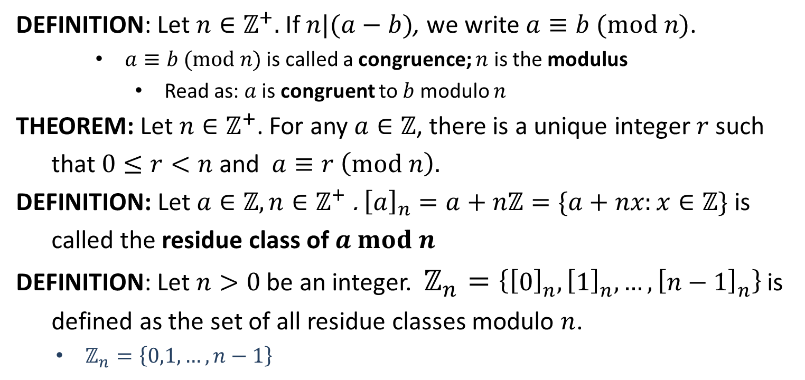
Congruence
DEFINITION: Let $n∈ℤ^{+}.$ If $n|(a−b)$, we write $a≡b (mod n)$.
$a≡b (mod n)$ is called a congruence; $n$ is the modulus
Read as: $a$ is congruent to $b$ modulo $n$
THEOREM: Let $n∈ℤ^{+}$. For any $a∈ℤ$, there is a unique integer $r$ such
that $0≤r<n$ and $a≡r \left(mod n\right).$
DEFINITION: Let $a∈ℤ,n∈ℤ^{+}$. ${\left[a\right]}_{n}=a+nℤ=\{a+nx:x∈ℤ\}$ is
called the residue class of $a mod n$
DEFINITION: Let $n>0$ be an integer. $ℤ_{n}=\left\{{\left[0\right]}_{n}, {\left[1\right]}_{n}, …, {\left[n−1\right]}_{n}\right\}$ is
defined as the set of all residue classes modulo $n$.
$ℤ_{n}=\left\{0,1,…,n−1\right\}$

Slide 16
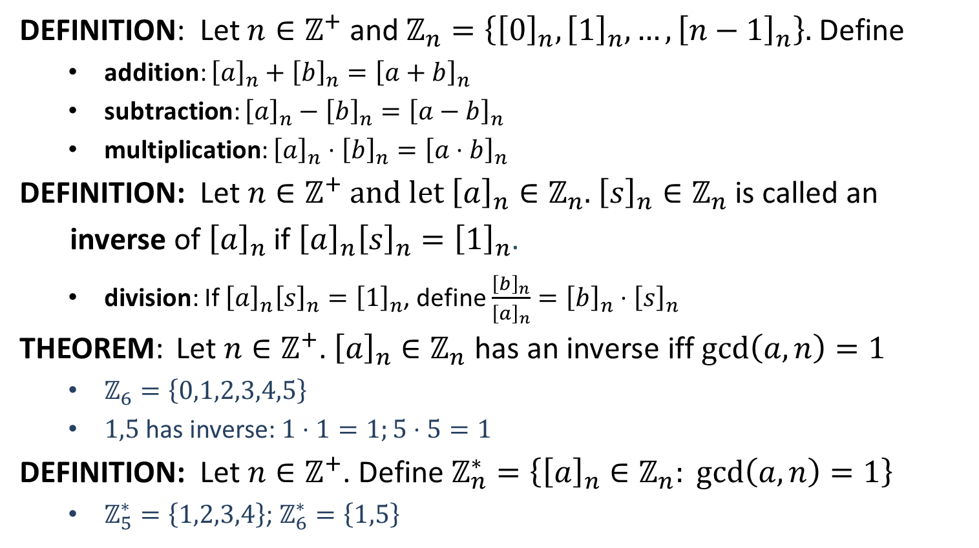
Residue Classes
DEFINITION: Let $n∈ℤ^{+}$ and $ℤ_{n}=\left\{{\left[0\right]}_{n}, {\left[1\right]}_{n}, …, {\left[n−1\right]}_{n}\right\}.$ Define
addition: ${\left[a\right]}_{n}+{\left[b\right]}_{n}={\left[a+b\right]}_{n}$
subtraction: ${\left[a\right]}_{n}−{\left[b\right]}_{n}={\left[a−b\right]}_{n}$
multiplication: ${\left[a\right]}_{n}⋅{\left[b\right]}_{n}={\left[a⋅b\right]}_{n}$
DEFINITION: Let $n∈ℤ^{+}$ and let ${\left[a\right]}_{n}∈ℤ_{n}$. ${\left[s\right]}_{n}∈ℤ_{n}$ is called an
inverse of ${\left[a\right]}_{n}$ if ${\left[a\right]}_{n}{\left[s\right]}_{n}={\left[1\right]}_{n}$.
division: If ${\left[a\right]}_{n}{\left[s\right]}_{n}={\left[1\right]}_{n}$, define $\frac{{\left[b\right]}_{n}}{{\left[a\right]}_{n}}={\left[b\right]}_{n}⋅{\left[s\right]}_{n}$
THEOREM: Let $n∈ℤ^{+}$. ${\left[a\right]}_{n}∈ℤ_{n}$ has an inverse iff $\gcd\left(a,n\right)=1$
$ℤ_{6}=\left\{0,1,2,3,4,5\right\}$
$1,5$ has inverse: $1⋅1=1;5⋅5=1$
DEFINITION: Let $n∈ℤ^{+}$. Define $ℤ_{n}^{∗}=\left\{{\left[a\right]}_{n}∈ℤ_{n}: \gcd\left(a,n\right)=1\right\}$
$ℤ_{5}^{∗}=\left\{1,2,3,4\right\}$; $ℤ_{6}^{∗}=\left\{1,5\right\}$

